Slide 2

Pharmacology of Antibiotics

Slide 3
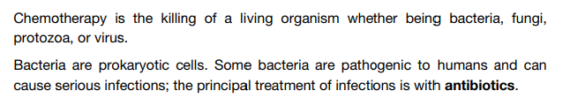
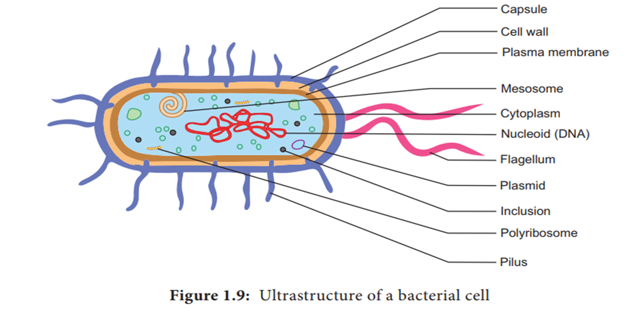
Principles of Antimicrobial therapy

Slide 4
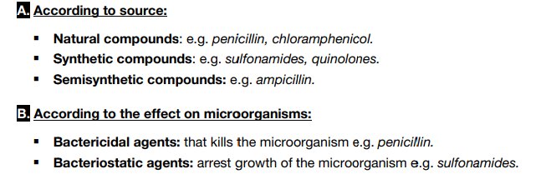
Classification of Antimicrobial Drugs

Slide 5
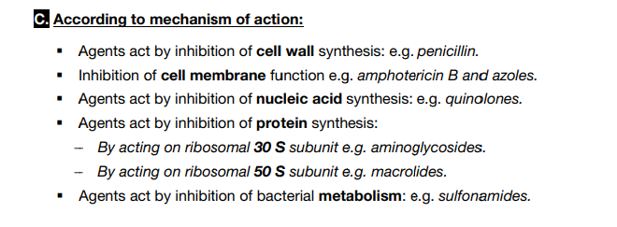
Classification of Antimicrobial Drugs

Slide 6
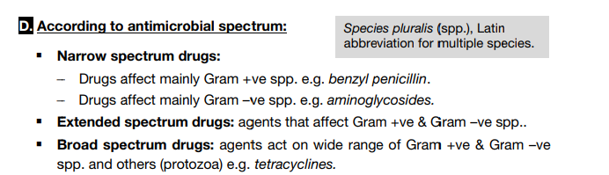
Classification of Antimicrobial Drugs

Slide 7
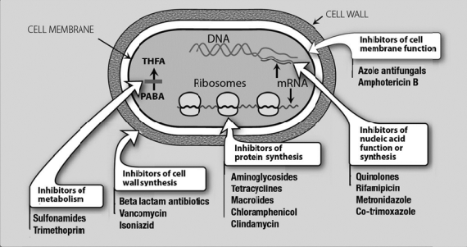
Site of Actions of Antibacterial Drugs

Slide 8
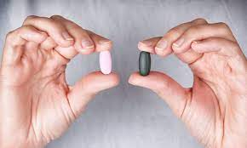
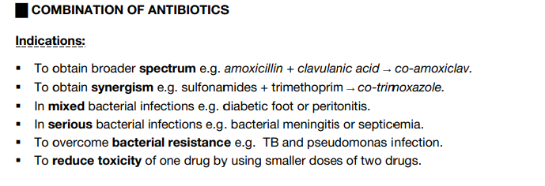

Slide 9
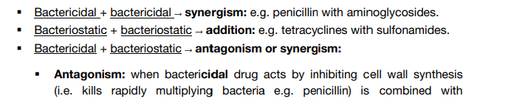
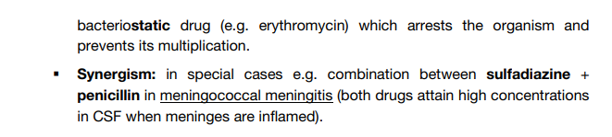
Results of Combination

Slide 10
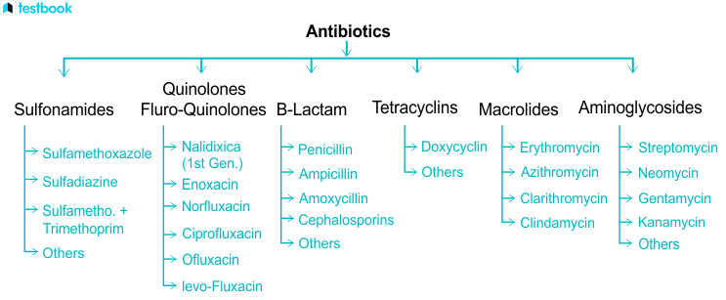
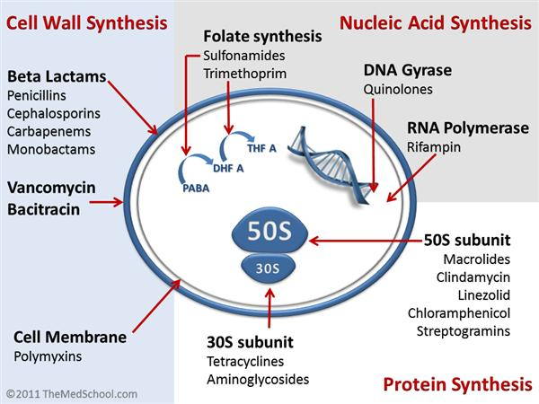

Protein synthesis inhibitors

Slide 11

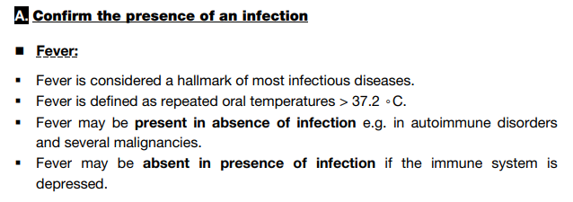
CLINICAL APPROACHES FOR RATIONAL PRESCRIBING OF ANTIBIOTICS

Slide 12

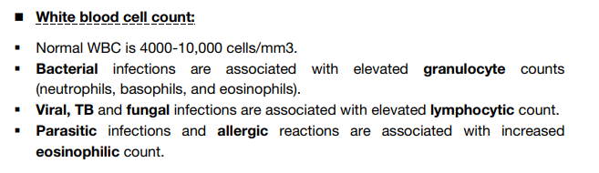
CLINICAL APPROACHES FOR RATIONAL PRESCRIBING OF ANTIBIOTICS

Slide 13
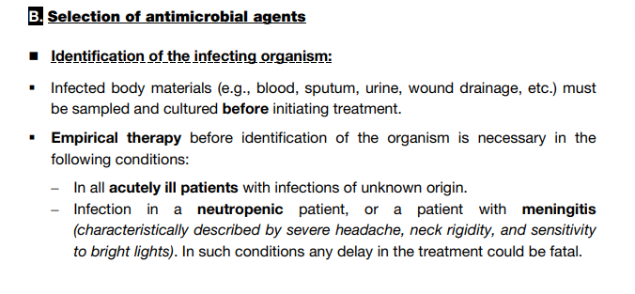
CLINICAL APPROACHES FOR RATIONAL PRESCRIBING OF ANTIBIOTICS

Slide 14

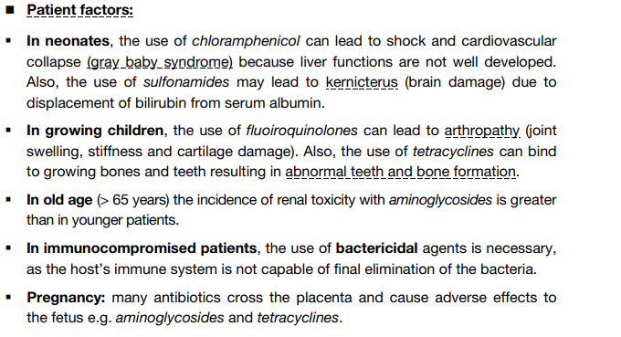
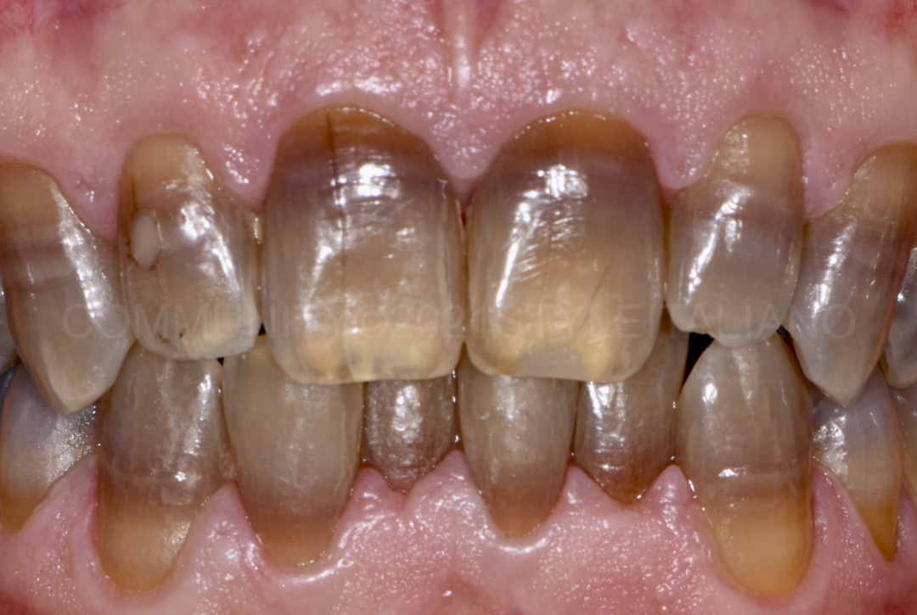
CLINICAL APPROACHES FOR RATIONAL PRESCRIBING OF ANTIBIOTICS

Slide 15
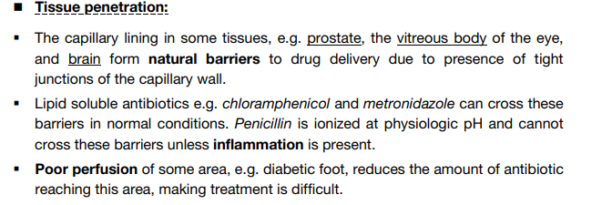
CLINICAL APPROACHES FOR RATIONAL PRESCRIBING OF ANTIBIOTICS

Slide 16
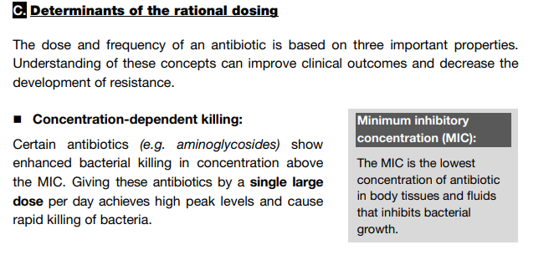
CLINICAL APPROACHES FOR RATIONAL PRESCRIBING OF ANTIBIOTICS

Slide 17
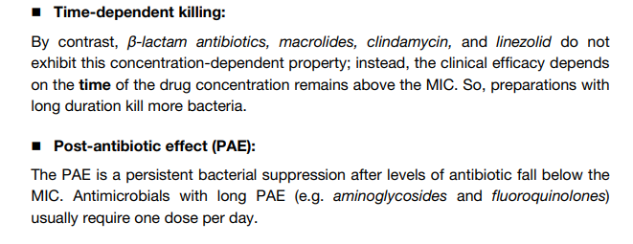
CLINICAL APPROACHES FOR RATIONAL PRESCRIBING OF ANTIBIOTICS

Slide 18
Pharmacodynamic properties of antibiotics
Type of bactericidal profile | Important parameter | Dosage optimization
Dose-dependent Aminoglycosides, quinolones | Cmax / MIC Prolonged PAE | Single daily dose
Time-dependent Penicillin, cephalosporins | T > MIC No PAE | Multiple DD or continuous infusion
Cumulative-dose dependent Clarithromycin, clindamycin | AUC / MIC Prolonged PAE | Total dose and duration
PAE: Post-Antibiotic Activity

Slide 19
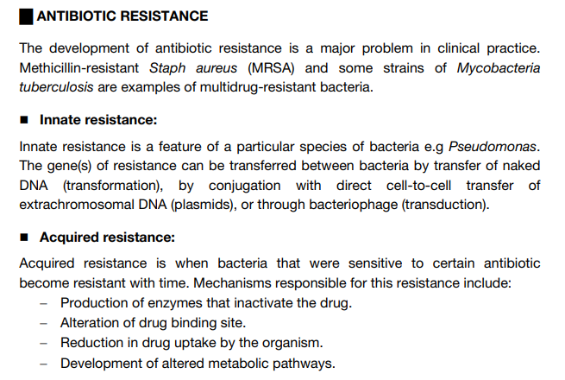
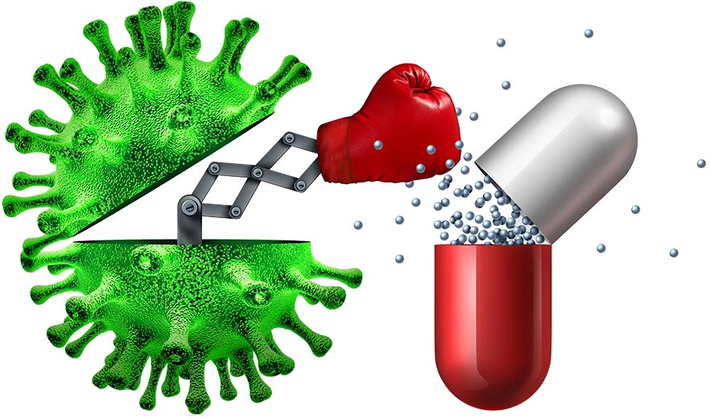
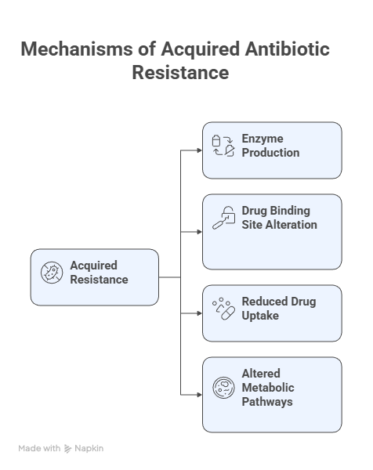
CLINICAL APPROACHES FOR RATIONAL PRESCRIBING OF ANTIBIOTICS

Slide 20
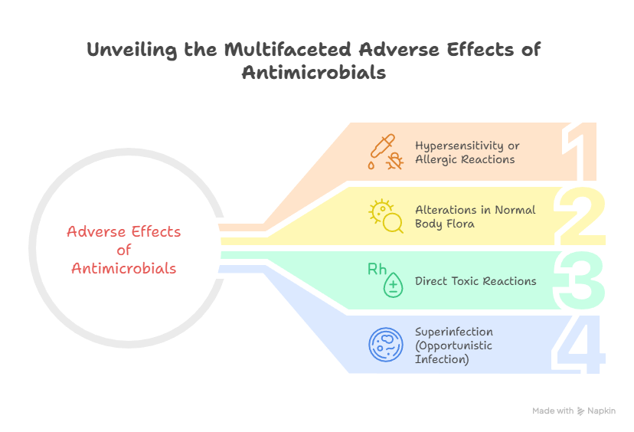
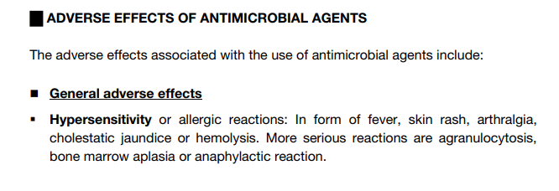
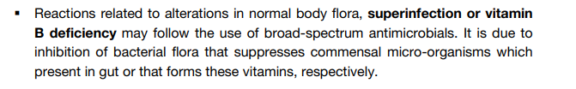
CLINICAL APPROACHES FOR RATIONAL PRESCRIBING OF ANTIBIOTICS

Slide 21
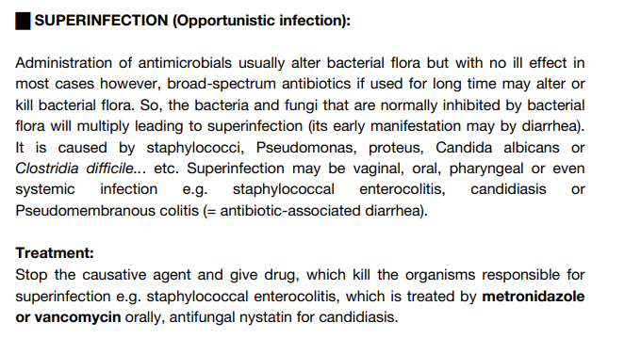
CLINICAL APPROACHES FOR RATIONAL PRESCRIBING OF ANTIBIOTICS

